Slide 1


Muhammad Azeem Qureshi
21st August, 2024

Slide 2

Objective
Predict the successful landing of the Falcon 9’s first stage using Data Science methodology.

Slide 3
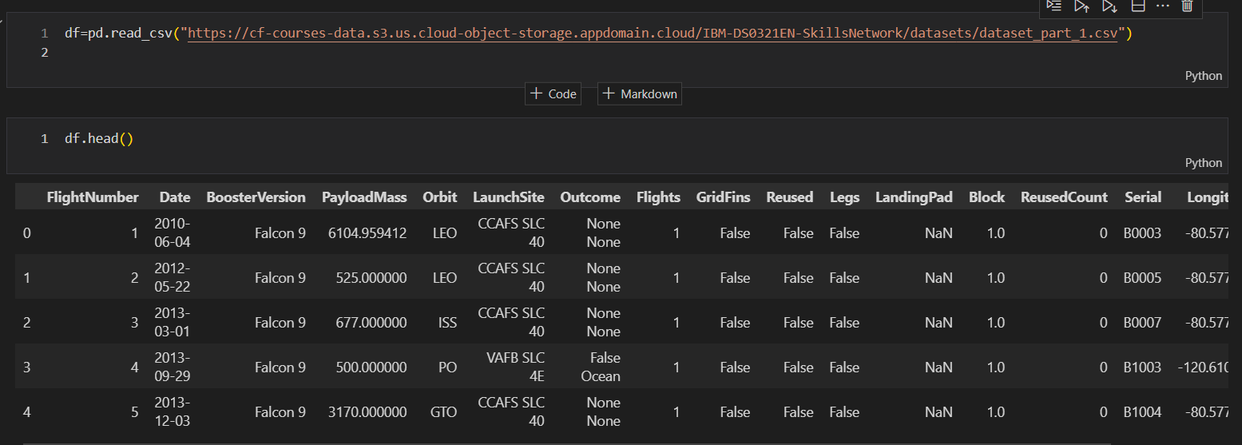
Data Collection
Description: Data collected from SpaceX Falcon 9 launches.
Features: FlightNumber, LaunchSite, PayloadMass, Orbit, Outcome, etc.

Slide 4
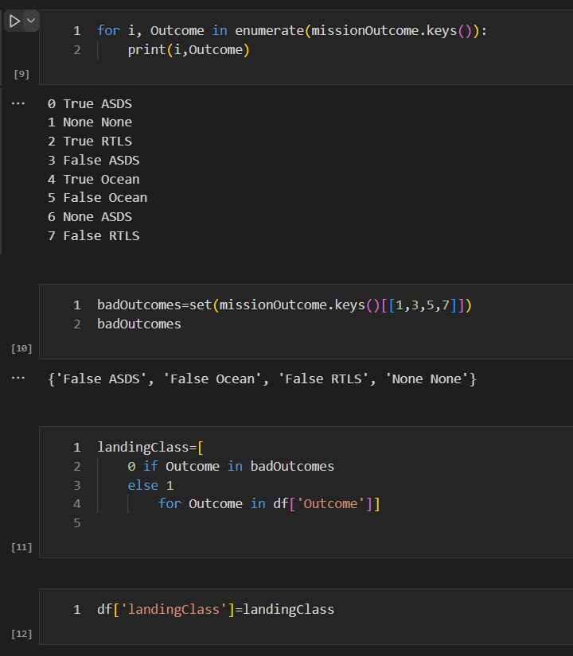
Data Wrangling
Data Cleaning: Handled missing Values and corrected inconsistencies
Feature Creation: Created ‘landingClass’ from mission outcomes

Slide 5
Exploratory Data Analysis

Slide 6
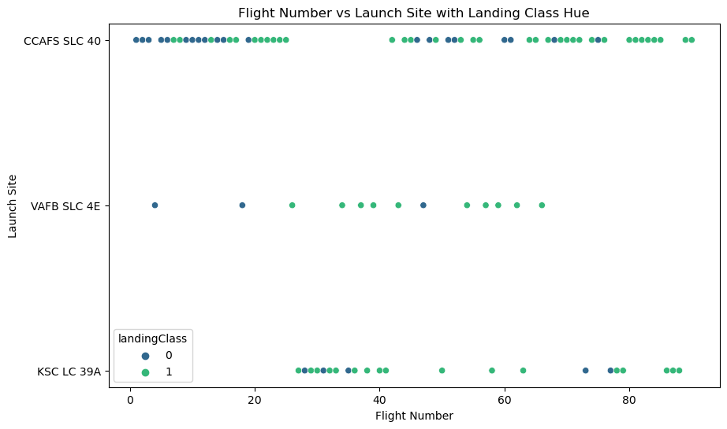
Flight Number by Launch Site

Slide 7
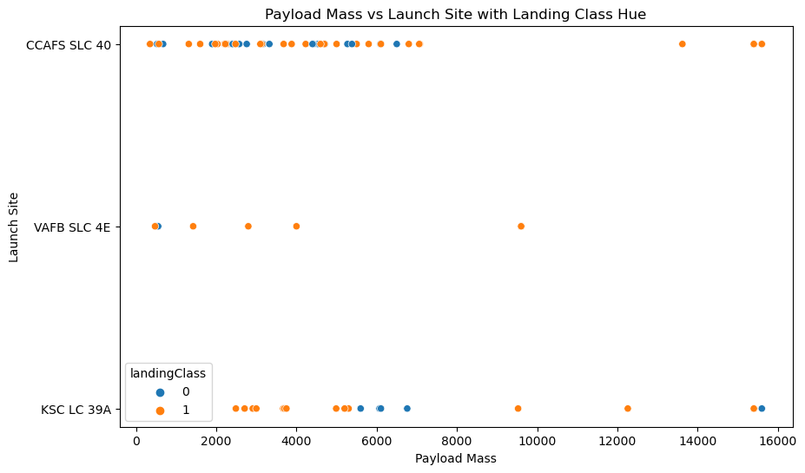
Payload by Launch Site

Slide 8
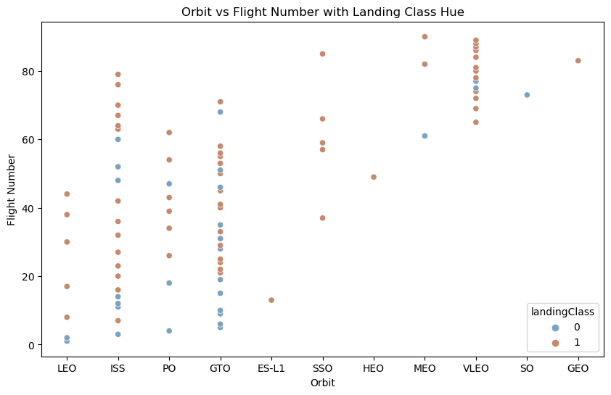
Orbit Type by Flight Number

Slide 9
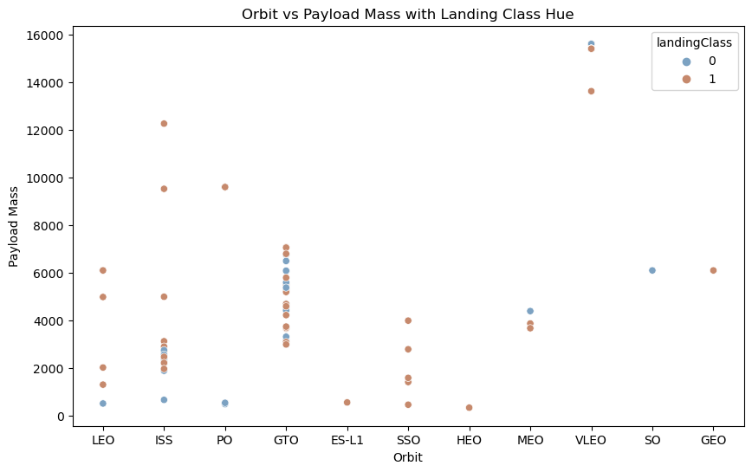
Orbit Type by PayLoad

Slide 10
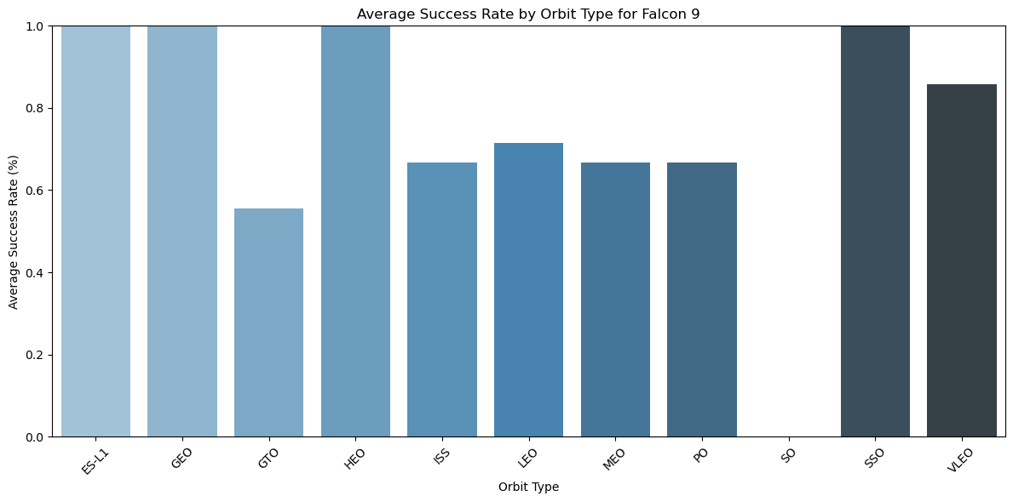
Success Rate by Orbit Type

Slide 11
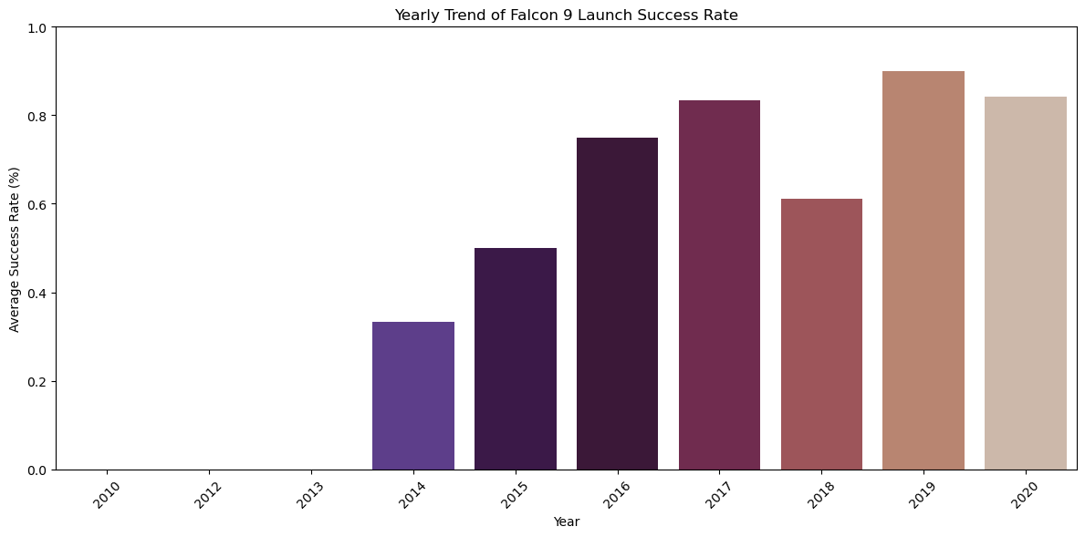
Yearly Success Rate

Slide 12
Feature Engineering

Slide 13
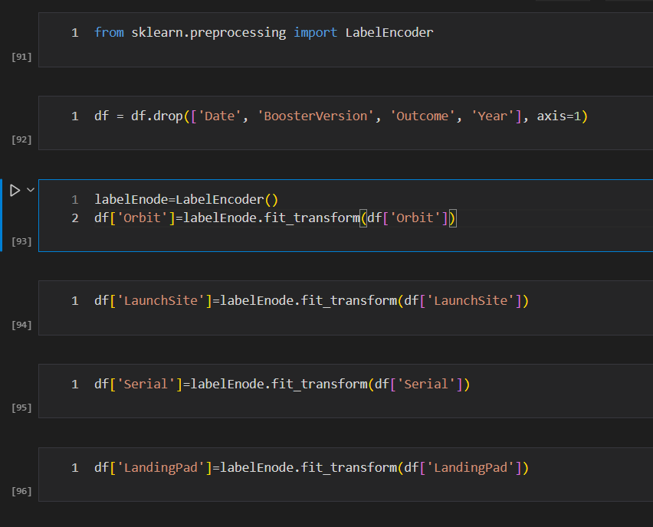
Feature Engineering
Actions Taken:
Dropped irrelevant columns.
Encoded categorical variables using Label Encoding.

Slide 14
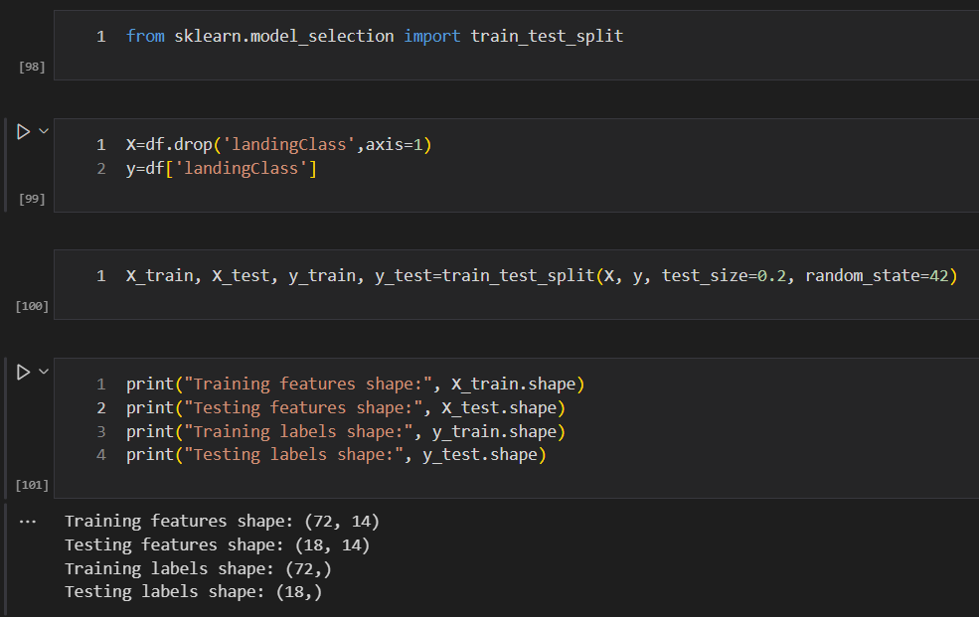
Train-Test Split and Shape

Slide 15
Model Development

Slide 16
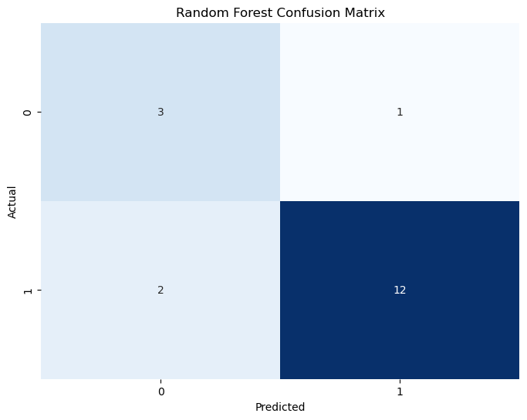
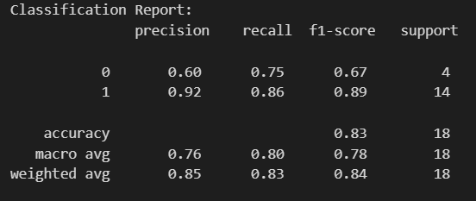
Random Forest Classifier
Accuracy: 0.833333334

Slide 17
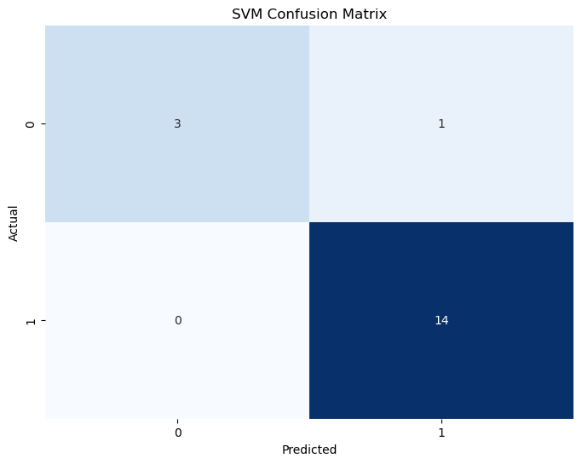
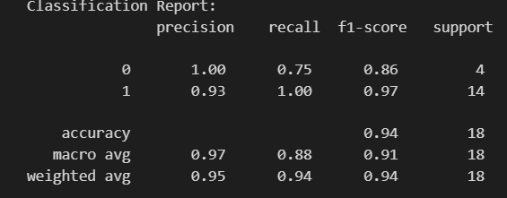
Support Vector Machine
Accuracy: 0.944444444444

Slide 18

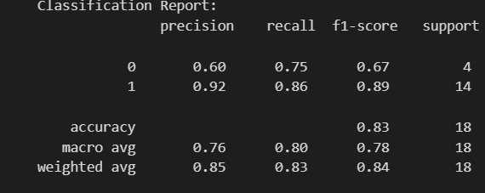
Multi Layer Perception
Accuracy: 0.8333333333334

Slide 19

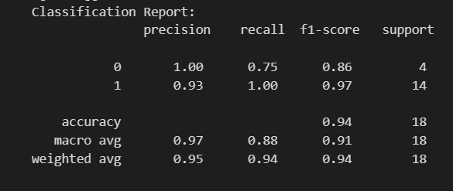
K-Nearest Neighbors
Accuracy: 0.944444444444

Slide 20
Model Comparison

Slide 21
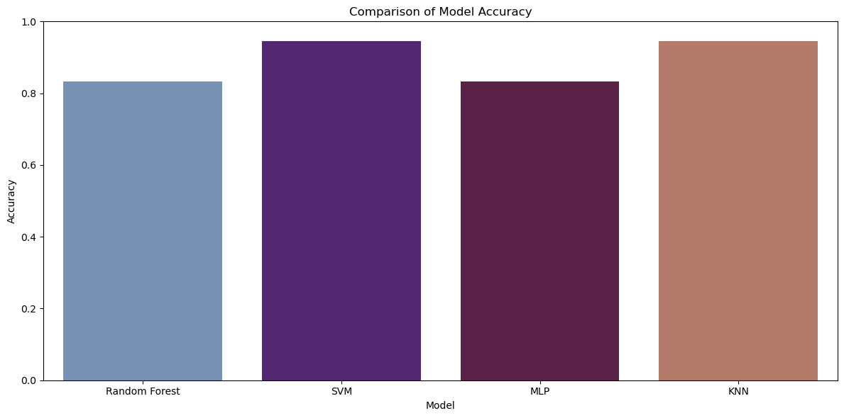
Classification Accuracy

Slide 22


